Slide 1

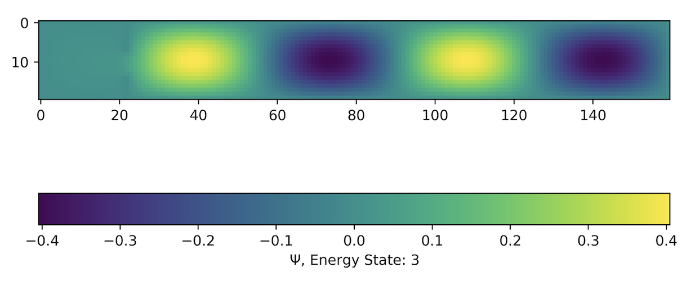
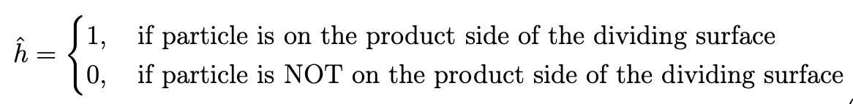
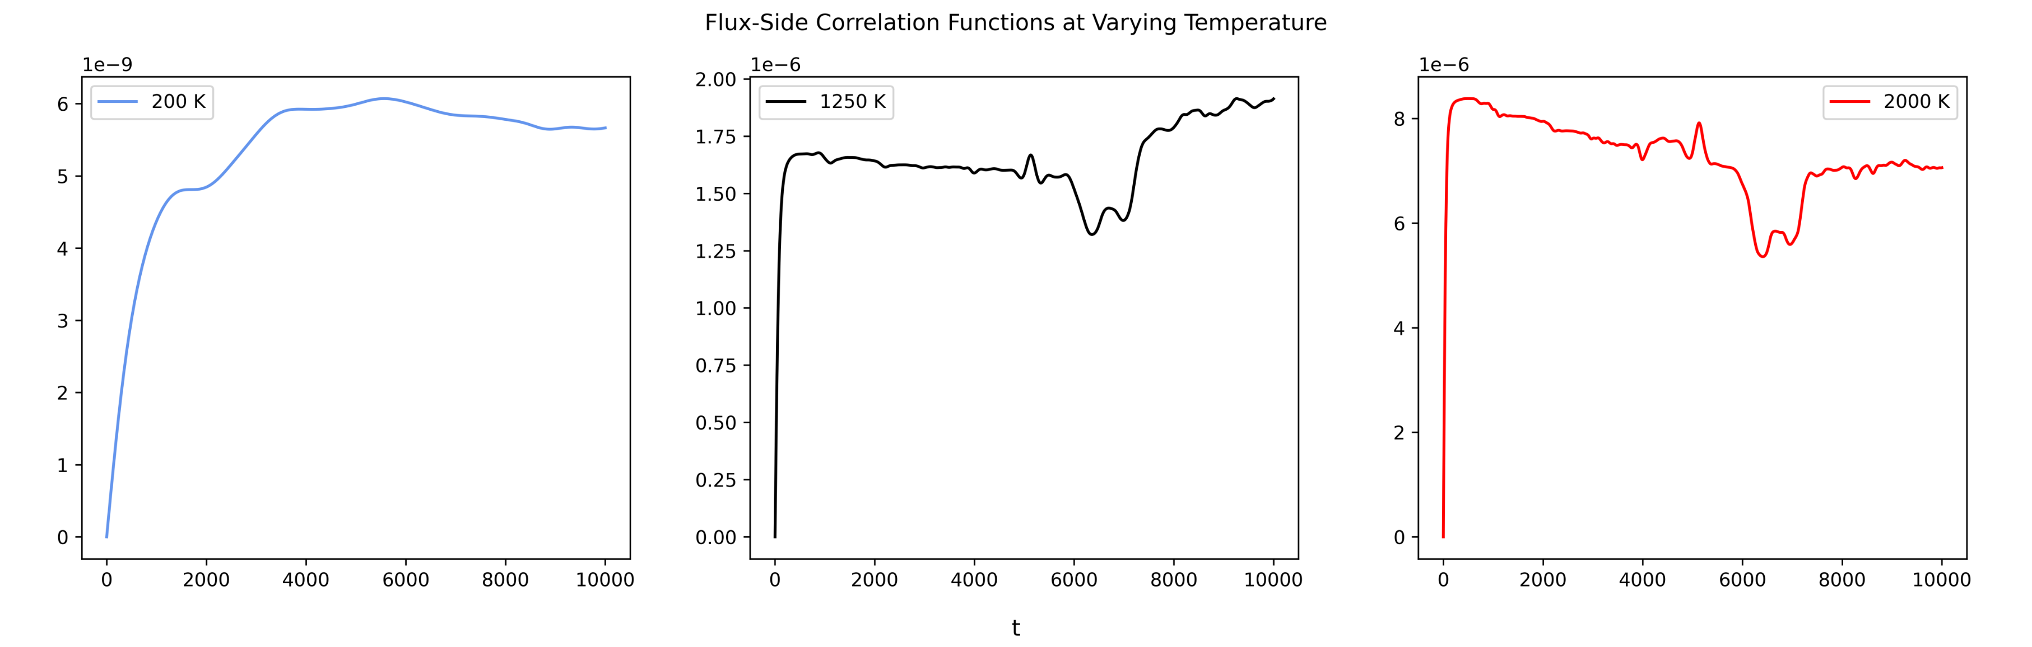
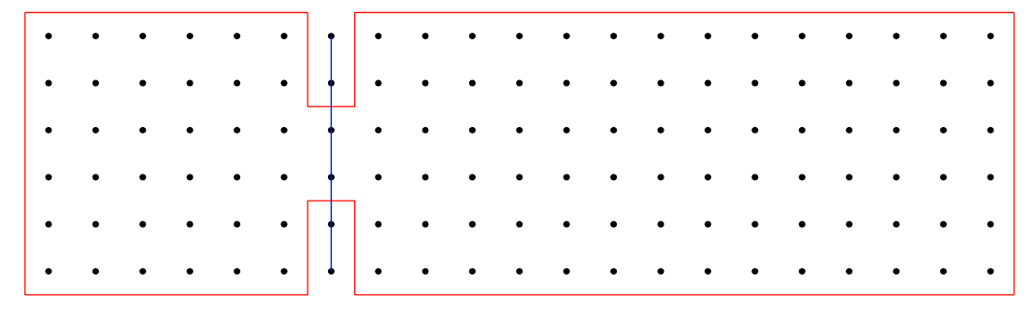
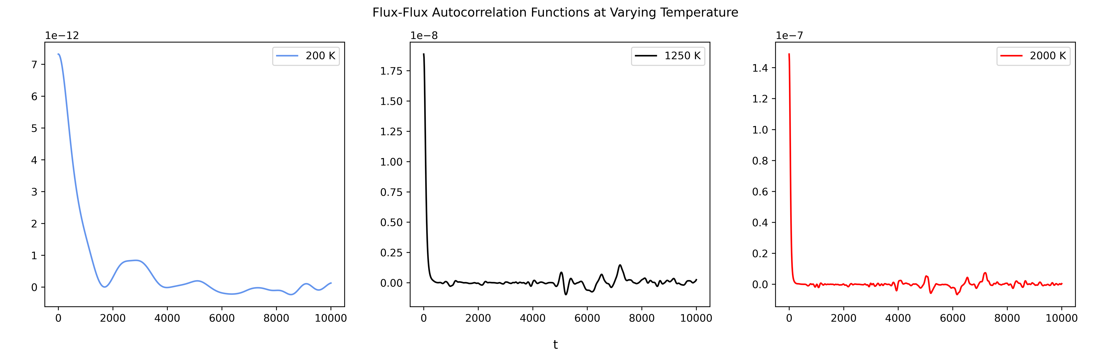
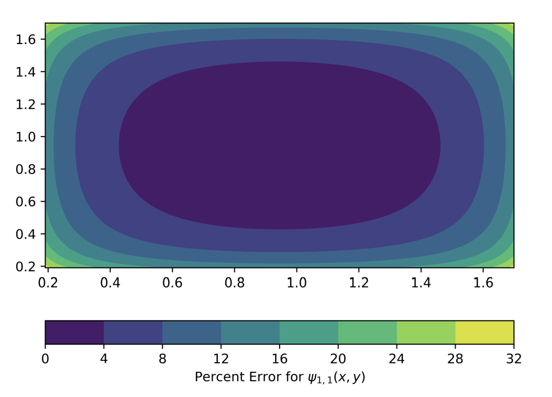
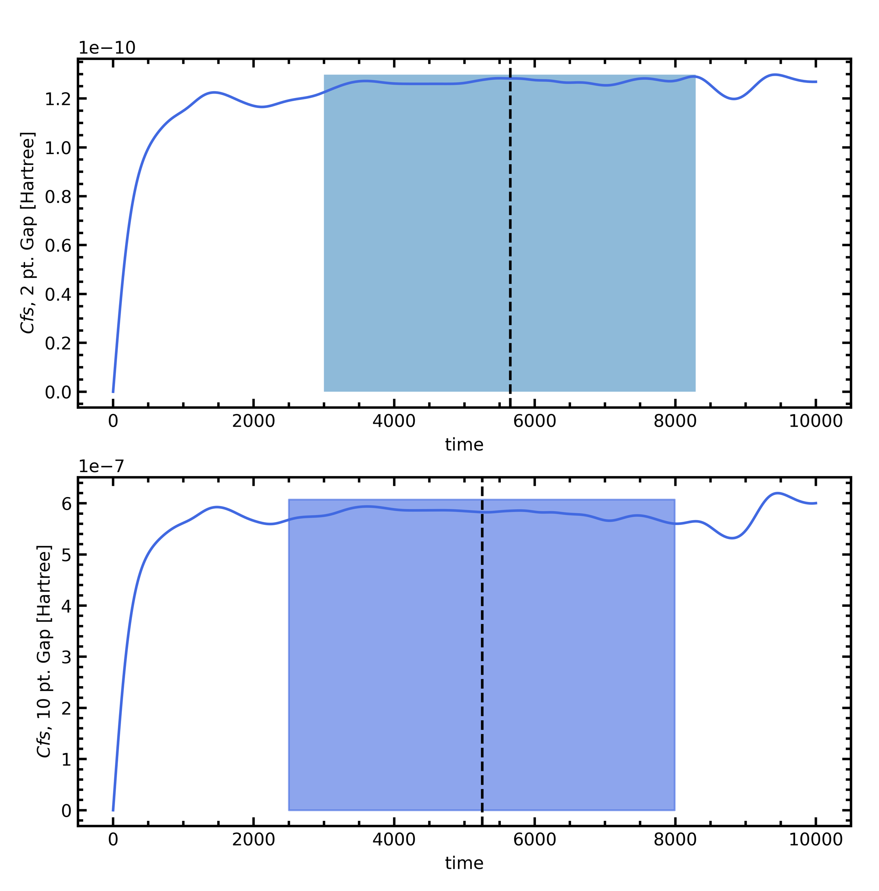
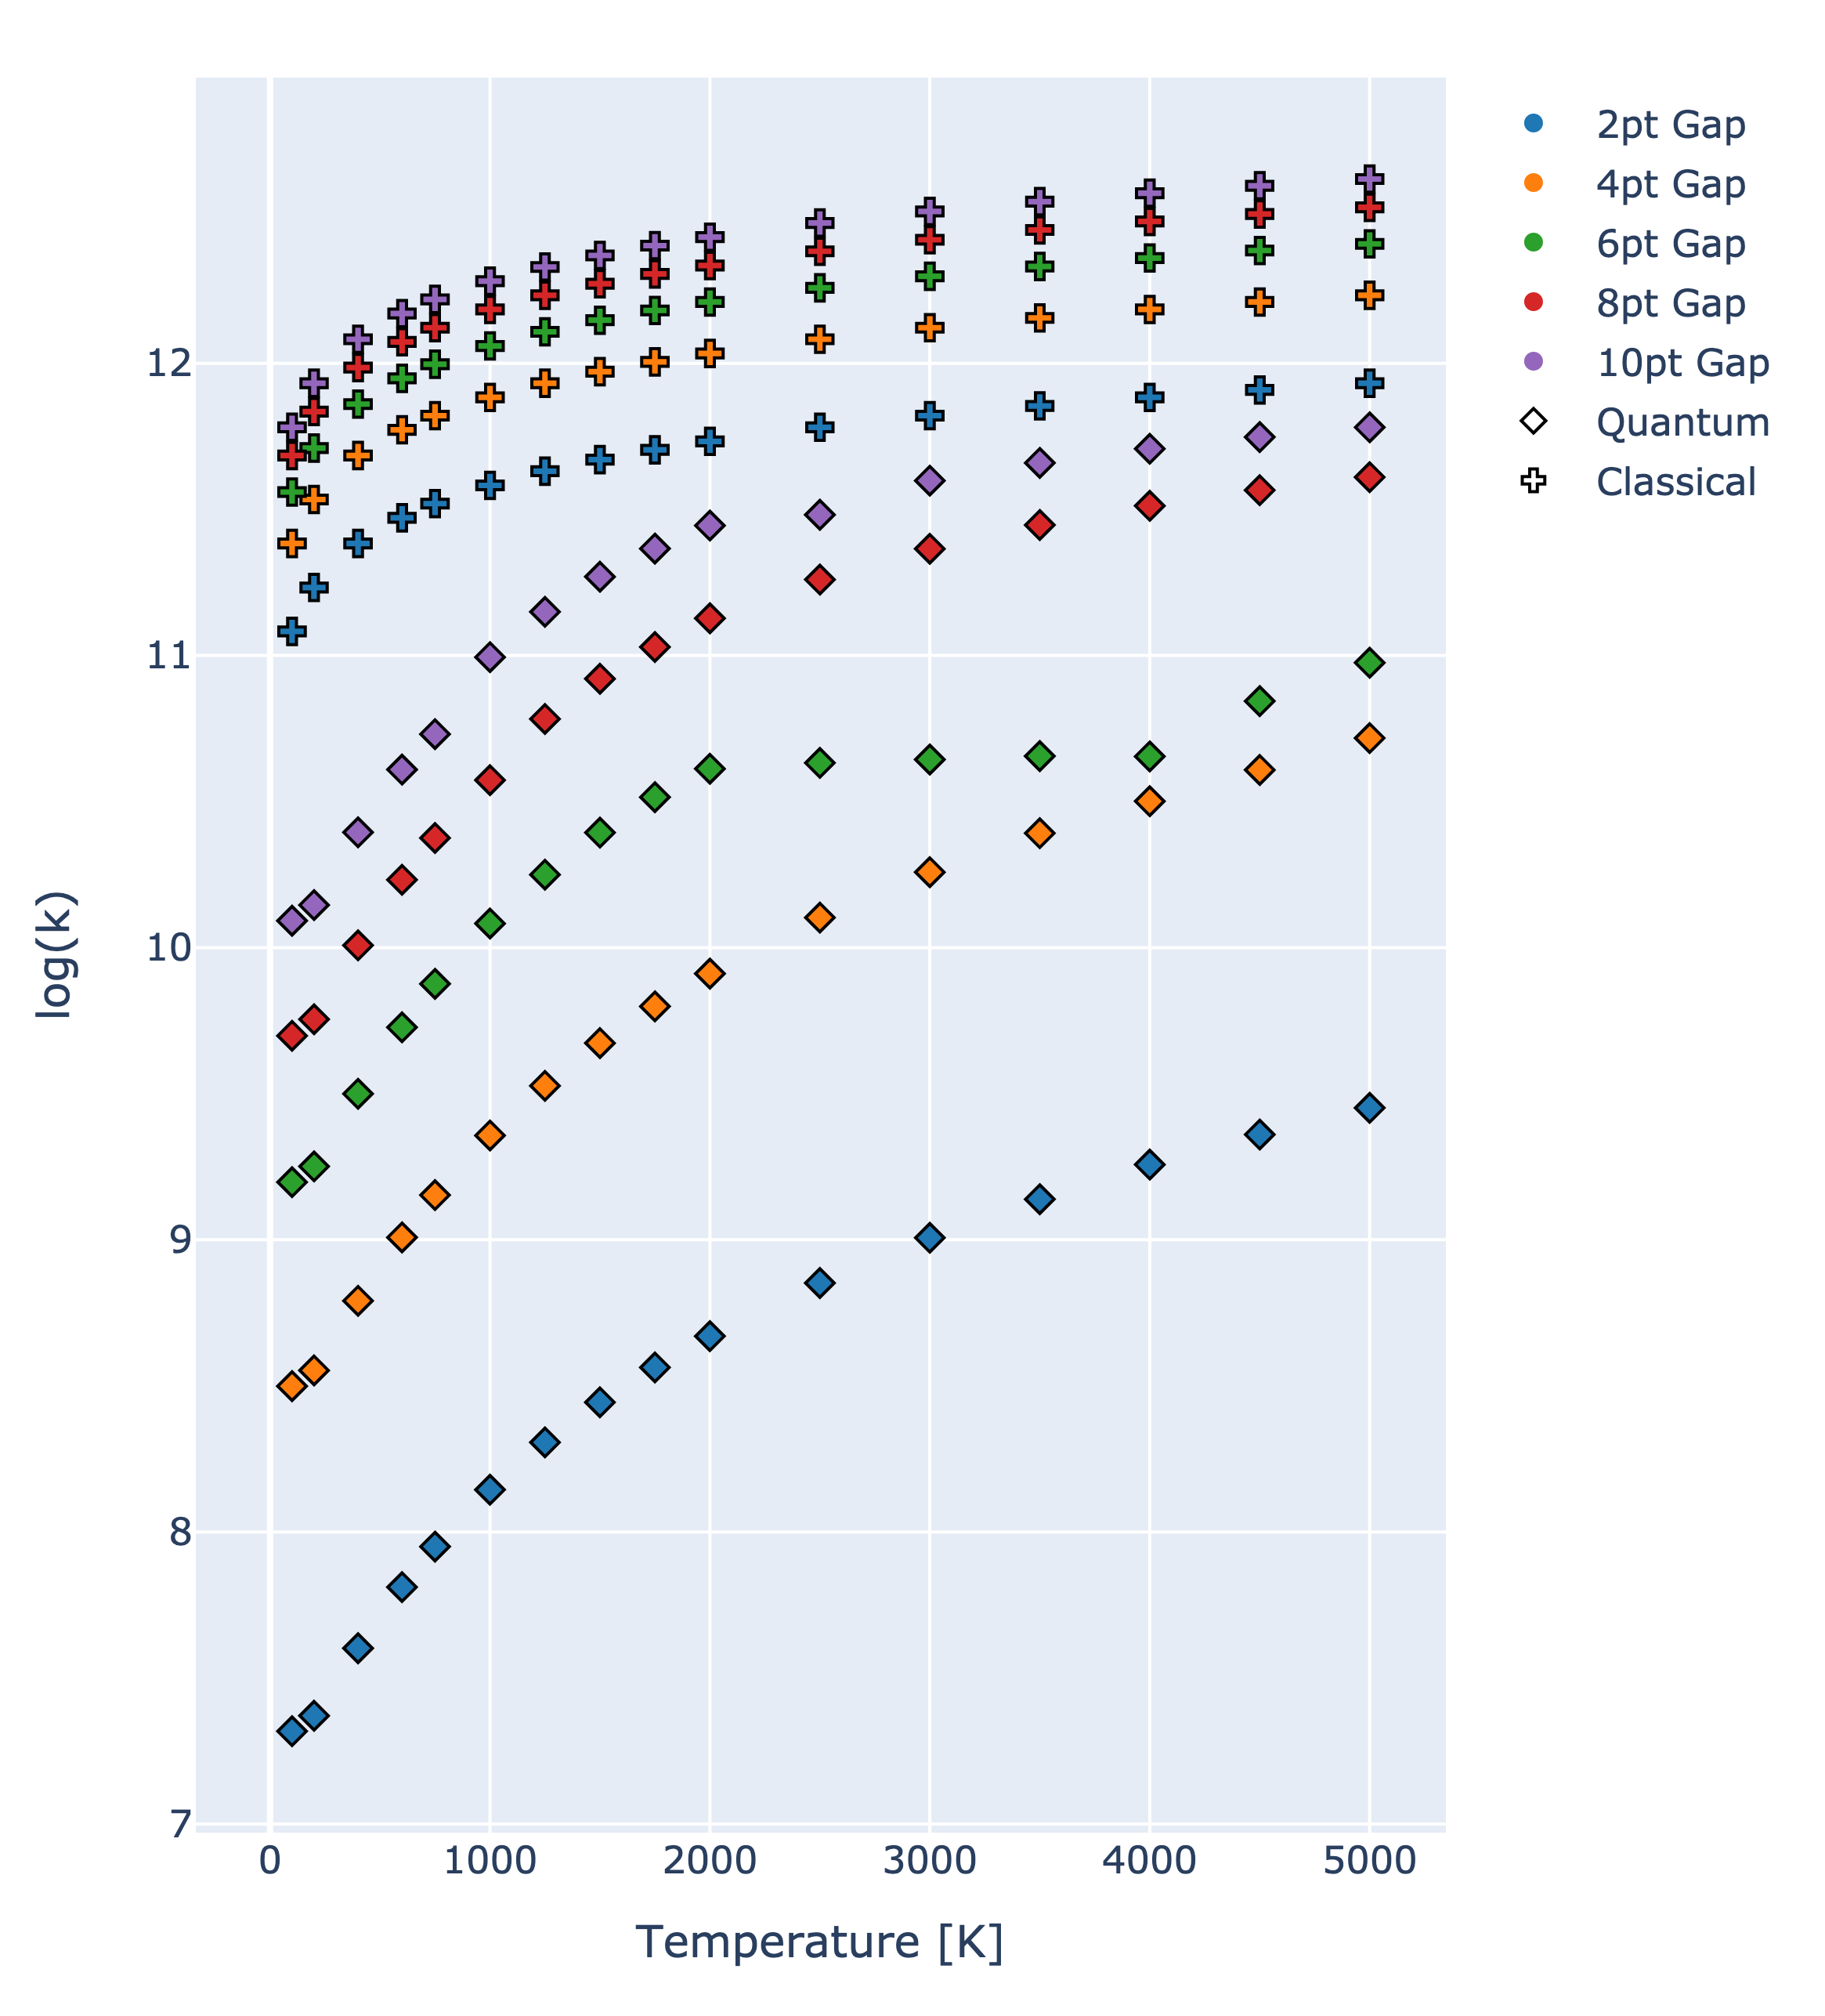
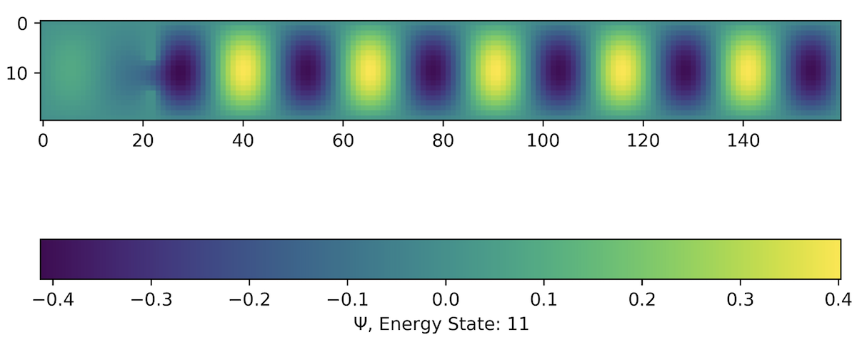
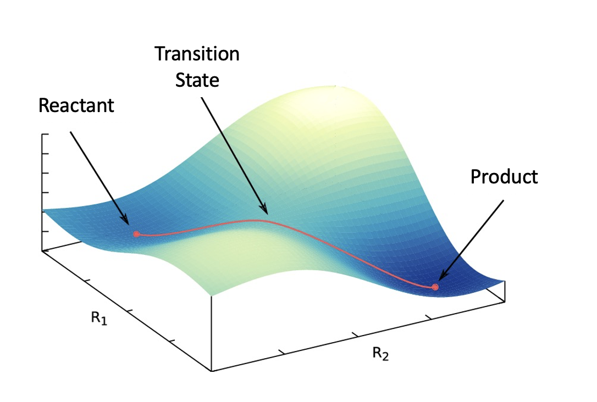






Working Towards a Quantum Transition State Theory via Quantum Effusion
Mohan Shankar†, Sergei Egorov†
†Department of Chemistry, University of Virginia
Introduction
In the field of kinetics, transition state theory (TST) is a well-known method for calculating reaction rates. The theory is classical in nature, however, and does not include quantum mechanical effects. Consequently, the Egorov group is interested in developing a quantum transition state theory (QTST) to describe systems where TST models would otherwise fail. To accomplish this, we compare the rates of effusion found from a quantum mechanical model with the classical results.
In order to accomplish this, we first begin by confirming the validity of our solver, comparing known results for the particle-in-a-box (PIB) system to numeric ones. From there, a slit for effusion was added, and correlation functions were calculated. Lastly, rates were extracted from the flux-side correlation functions ($C_{f,s}$) through dividing by the partition function, Q_{r}(T).
Correlation Functions
Correlation functions provide information about how closely two variables are related. We are particularly interested in the flux-side and side-side correlation functions, which elucidate the relationship between how many particles have crossed the dividing surface and how many particles are on the product side at a given time.¹
$$C_{f}\left(t\right)=Tr[\hat{F}\exp\left(\frac{\hat{iH}t}{ℏ}\right)\exp\left(−\frac{β\hat{H}}{2}\right)\hat{F}\exp\left(−\frac{β\hat{H}}{2}\right)\exp\left(\frac{\hat{iH}t}{ℏ}\right)]$$
$$C_{f,s}\left(t\right)=Tr[\hat{F}\exp\left(\frac{\hat{iH}t}{ℏ}\right)\exp\left(−\frac{β\hat{H}}{2}\right)\hat{h}\exp\left(−\frac{β\hat{H}}{2}\right)\exp\left(\frac{\hat{iH}t}{ℏ}\right)]$$
$$C_{s}\left(t\right)=Tr[\hat{h}\exp\left(\frac{\hat{iH}t}{ℏ}\right)\exp\left(−\frac{β\hat{H}}{2}\right)\hat{h}\exp\left(−\frac{β\hat{H}}{2}\right)\exp\left(\frac{\hat{iH}t}{ℏ}\right)]$$
$$C_{f}\left(t\right)={\dot{C}}_{f,s}\left(t\right)={\ddot{C}}_{s}\left(t\right)$$
*H. Mortensen, et al., J. Chem. Phys. 116, 5781-5794 (2002)
Figure 1: Third excited state of ψ_{PIB} in the presence of a slit.
Figure 11: Different adsorption sites on Pt(111)
Quantum Effusion
For many quantum mechanical problems, the Schrödinger Equation $\hat{H}Ψ=EΨ$and its solution will be necessarily introduced and utilized. While the elementary PIB system is easy to solve analytically, the introduction of a slit leaves a solution analytically infeasible yet numerically amenable.
As such, the first step in the solution process was to spatially discretize the system via the construction of a Hamiltonian matrix and compare our numerical results for the PIB to the known, analytic solution. Once those results were verified, we introduced a slit to the system, depicted in Figure 2.
The flux-side and flux-flux correlation functions were obtained for the slit system over a range of different temperatures as depicted in Figure 6. At higher temperatures, the system becomes unstable and collapses after some time has elapsed. However, the functions obtained all show a region of desirable plateau that will be used to extract the quantum rates, kQ. Increasing the total number of time steps is also currently being explored.
Figure 2: Diagram showing what the system looks like (not to scale). The black points depict equispaced points in a grid corresponding to the spatial discretization. The red lines represent the walls where the value of the wavefunction at and outside the walls are set to zero. The left box represents the area where the particle is initially placed while the right box is where the particle effuses into. Lastly, the blue line represents the dividing surface which is later used to calculate the flux.
Analytical Wavefunctions
During this process, it was important to ensure the system that was created produced accurate results when compared to the known solution. For the 2D particle in a box:
$$\hat{H}≡−\frac{ℏ^{2}}{2m}\left(\frac{∂^{2}}{∂x^{2}}+\frac{∂^{2}}{∂y^{2}}\right)$$
$$Ψ_{nx,ny}=\frac{2}{L}\sin\left(\frac{n_{x}πx}{L_{x}}\right)\sin\left(\frac{n_{y}πx}{L_{y}}\right)$$
When we compared our numeric solutions to the analytical one, we found marginal error at the corners of the box, but insignificant error in the center and toward the edges as depicted in Figure 3. We then moved on to the slit system, which has no analytical solutions.
Figure 6: Top) Series of graphs depicting flux-side correlation functions at 200, 1250, and 2000 K. Bottom) Series of graphs depicting flux-flux correlation functions at 200, 1250, and 2000 K.
Reaction Rates
Figure 3: Percent error of numeric solution for the 2D particle in a box relative to the analytic solution.
When a slit is introduced, the solutions to the Schrödinger Equation ($ψ$) change such that the wavefunction primarily exists in the products region, though there is some recrossing to the reactant region at higher energy states, depicted in Figure 4.
Figure 4: The 10th excited state of the particle in a box system in the presence of a slit. For an insufficiently large system, recrossing into the reactant region occurs at high energy.
Calculating Flux
For transition state theory, the choice of where to place the dividing surface is crucial for obtaining accurate rates. In order to extract rates of effusion from our system, we implement the quantum mechanical flux operator
$$<φ\left|\hat{F}\right|ψ> =\frac{1}{2m}\left[φ^{∗}\hat{p}ψ−ψ^{∗}\hat{p}φ\right]$$
where $\hat{p}$ is the quantum mechanical momentum operator. From here we find the second derivative over the dividing surface to determine the flux squared factors, which are necessary to generate the correlation functions.
Figure 7: Flux-side correlation functions of different gap sizes with the plateau highlighted.
Figure 8: Log of extrapolated rates as wall thickness tends to 0 from correlation functions at varying temperatures and gap sizes.
Figure 5: Example of an arbitrary reaction and dividing surface.
From the flux-side correlation functions ($C_{f,s}$), rates can be found by identifying plateaus and extracting the y-value. Once a relevant $C_{f,s}(t)$ is found, we divide by the partition function calculated in order to produce a rate.
(1) W. H. Miller, S. D. Schwartz, J. W. Tromp, J. Chem. Phys. 79, 4889 (1983).

